Slide 1
RB Apes
Raghav Babbar
MCA 2nd Shift
00150404421

Slide 2
Introduction
RB Apes is the NFT marketplace where a user puts an NFT for sale, the ownership of the item will be transferred from the creator to the marketplace contract.
We connect a react.js application to blockchain and pair it with Ethereum Web Client Library using Metamask wallet.
The marketplace logic will consist of just one smart contract which will allows users to mint NFTs and list them in a marketplace.

Slide 3
Technology
React JS
Third Web
Web 3.0 Dapp
Etherium
Tailwind CSS
MetaMask
Infura

Slide 4
Objective
With block chains, the main goal is to provide an authentic digital product that is unique.
It is a one-of-a-kind asset with no other copies.
Even though Ethereum is the leading block chain many others are capable of implementing their own NFTs.
Non Fungible Tokens can be anything from games to digital items.

Slide 5
MODULE
Connect Wallet:- In this module, user can connect his/her MetaMask wallet with the website.
Listing NFT:- In this module, connected user can see all the active NFT listed in Third Web.
Purchasing NFT:- In this module, connected user can purchase a NFT which he/she selected.
Dashboard:- In this module, connected user can see all the NFT he/she purchased/owned.

Slide 6
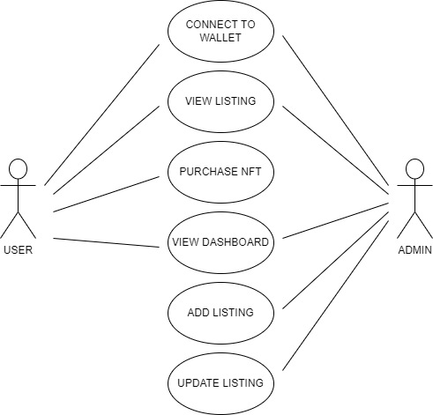
USE CASE

Slide 7
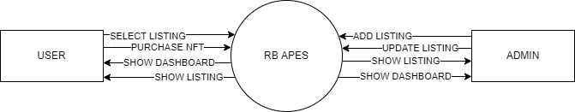
DFD Level-0

Slide 8
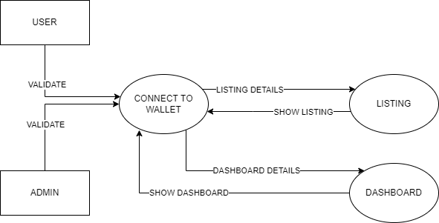
DFD Level-1

Slide 9
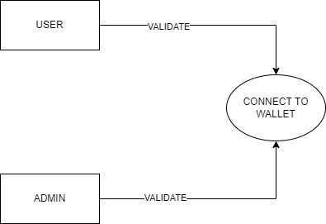
DFD LEVEL-2 CONNECT TO WALLET

Slide 10
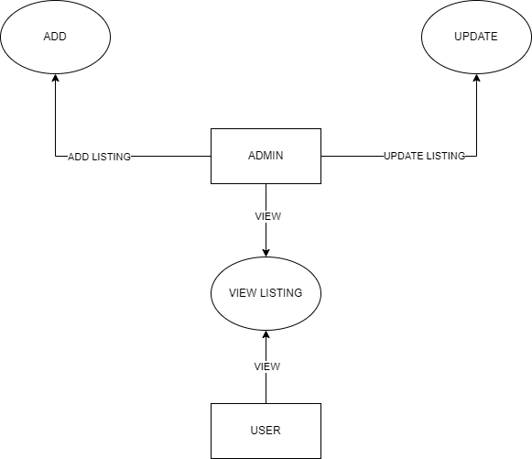
DFD LEVEL-2 LISTING

Slide 11
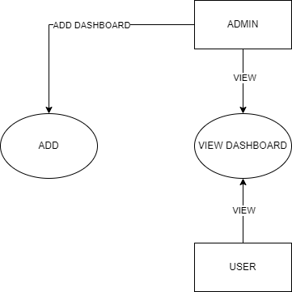
DFD LEVEL-2 DASHBOARD

Slide 12
THANK YOU

